Slide 1
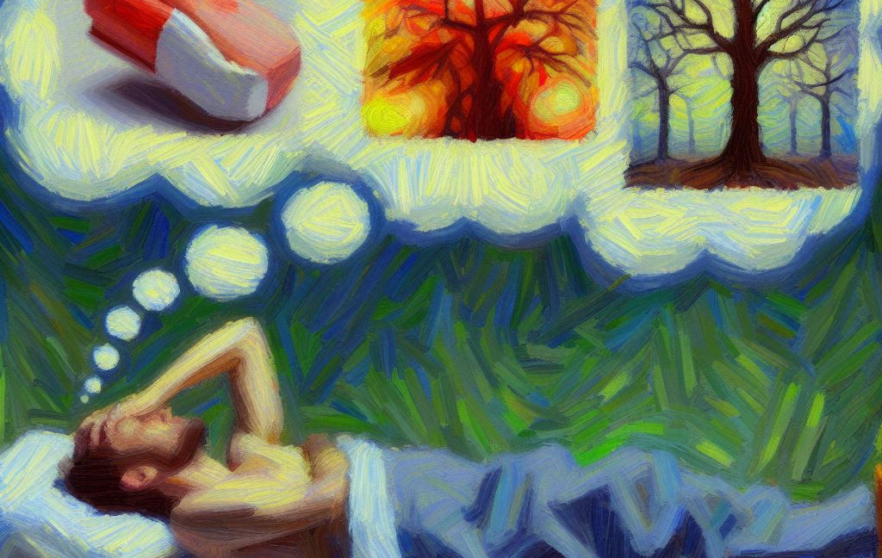
Joy – Placebo Despair – Nocebo
BIO-698
Timothée Ferrari
30.11.2023
Produced with Image Creator from Designer

Slide 2
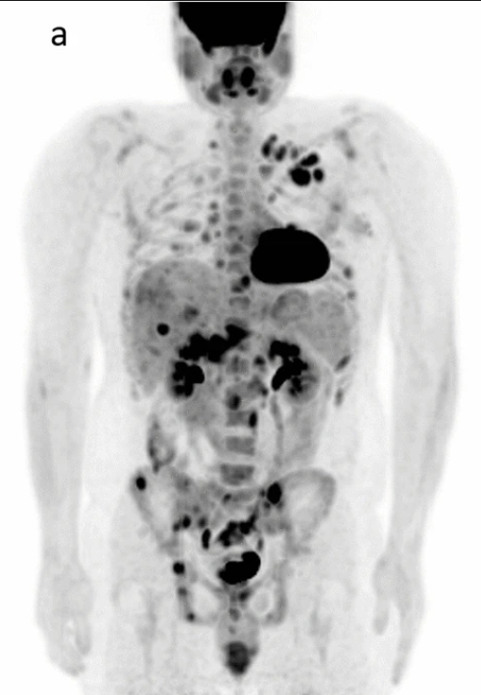
The story of Mr. Wright 1957
DX: Advanced lymphosarcoma
Multiple treatment failures
Final hope: Krebiozen (horse serum derivative)
It worked!!
Al-Ibrahim, Sci Rep 12, 2022

Slide 3
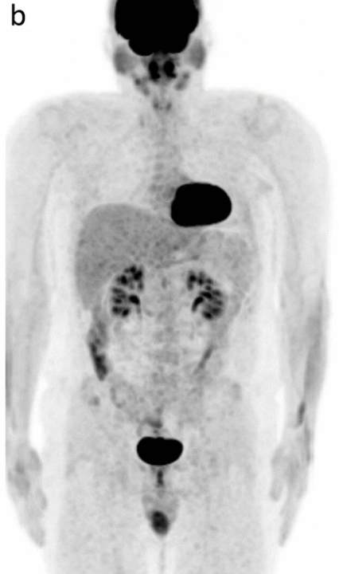
The story of Mr. Wright 1957
Al-Ibrahim, Sci Rep 12, 2022

Slide 4

The story of Mr. Wright 1957
Press release claiming inefficacy
Starts stressing out
Clinicians decide to lie and say it works
Replace with saline solution
Eventually AMA publishes official announcement
https://www.vectorstock.com/royalty-free-vector/ghost-rising-from-grave-vector-20453192

Slide 5
How would you define placebo/nocebo?

Slide 6
Benedetti’s definition of placebo Neuron, 2014
A placebo is an inert treatment with no specific therapeutic properties
The placebo effect is the response to the inert treatment.
Although this is the most common definition,
it is not completely correct,
for placebos are made of many things, such as words, rituals, symbols, and meanings

Slide 7
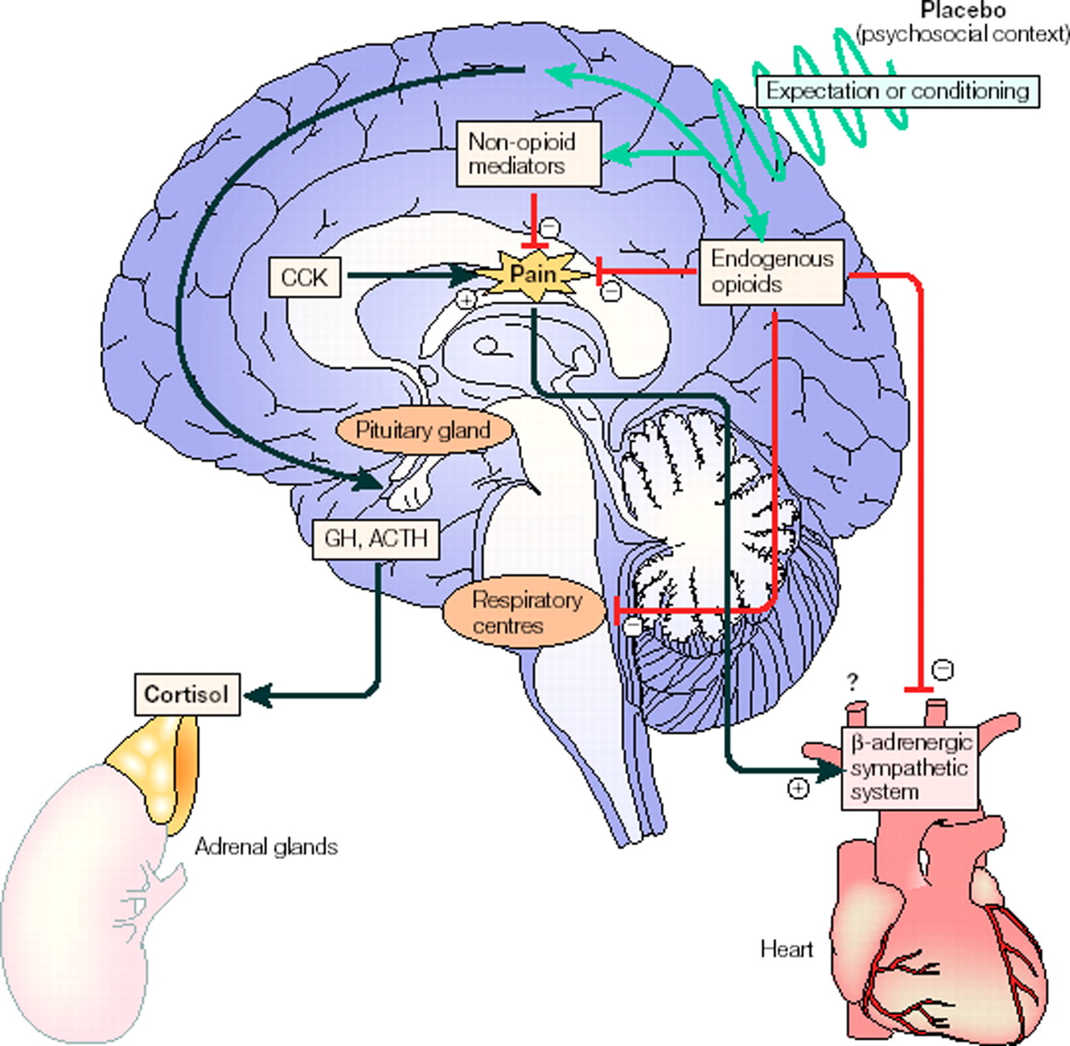
Neurobiology of placebo
Concept introduced in 1978
Placebo analgesia blocked by opioid antagonist naloxone
Opioid & non- mechanisms
If expectation high, naloxone sensitive
Benedetti et al., J Neuro Sci, 2005
Notes:
CCK: Cholecystokinin
CCK antagonist proglumide was found to enhance placebo analgesia through the potentiation of placebo-activated opioid systems

Slide 8
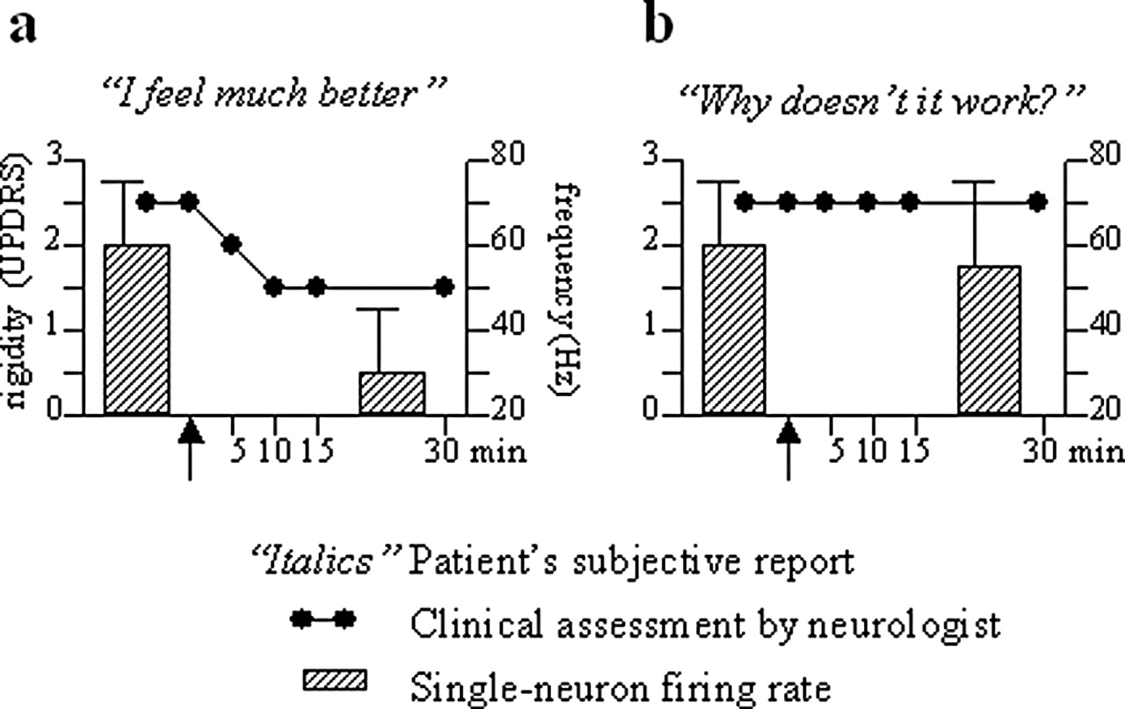
Relating neuron firing rates & placebo in Parkinson’s Disease
Benedetti et al., J Neuro Sci, 2005

Slide 9
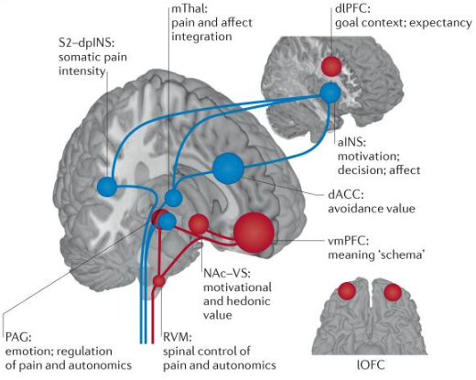
Physiology of placebo: Autonomic responses
Autonomic responses regulated by prefrontal cortex
Placebo analgesia: Binding of D2/D3-R & µ-R in dlPFC
D2/D3/D4-R: Regulate response-related neuronal firing
Benedetti et al., J Neuro Sci, 2005

Slide 10
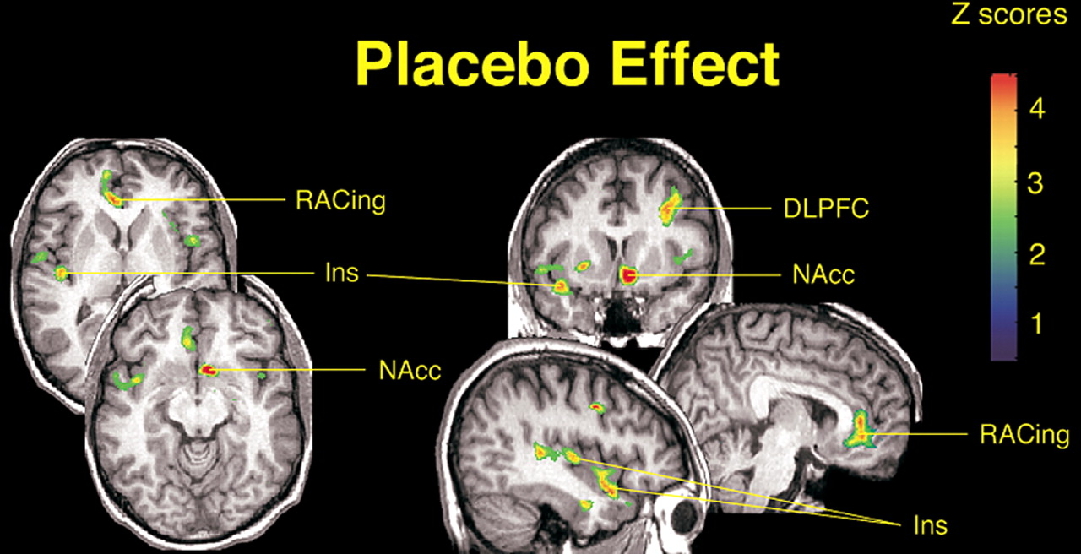
Notes:
Nacc: Nucleus accumbens → Considered the neural interface between motivation and action, modulating responses and inputs in the limbic system & output to the motor system.
The limbic system is overall composed of the thalamus and hypothalamus & basal ganglia. Which are responsible for the regulation of mood & emotions, which has a major impact on cognitive ability, whereas the basal ganglia regulates reward processing, habit formation, movement & learning

Slide 11
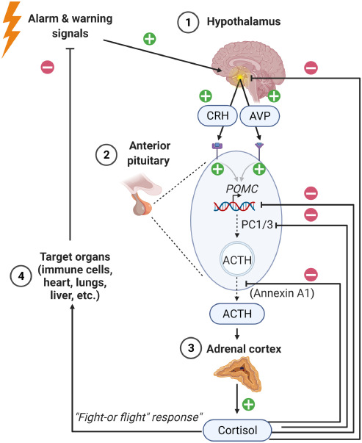
Physiology of placebo: Neuro-endocrine responses
Placebo can affect the hypothalamic-pituitary-(adrenal) axis
Nocebo suggestions that treatment will cause pain can increase peripheral cortisol
Chronic cortisol increases → “Resistance” → ↑ stress hormones & inflammatory cytokines
Van den Berghe et al., J EBioM, 2022

Slide 12
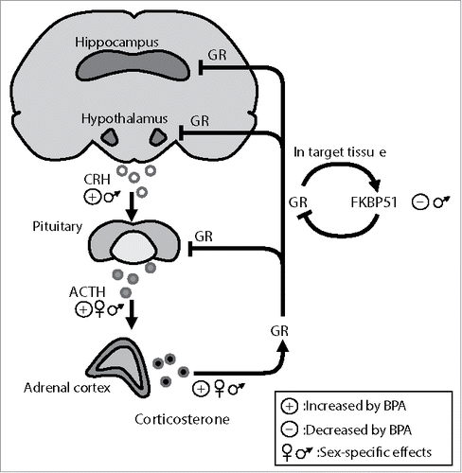
Depression as a nocebo-like pathology?!
Narrative matters: A good story makes us feel good
Depression leads to self-deprecation: We create a bad narrative
Parallels in changes in brain activity: Similar neuronal pathways impacted
↑ cortisol, CRH, non-suppression on dexamethasone suppression test, blunted ACTH response to CRH
Narrative matters: A good story makes us feel good
Depression leads to self-deprecation: We create a bad narrative
Parallels in changes in brain activity: Similar neuronal pathways impacted
↑ cortisol, CRH, non-suppression on dexamethasone suppression test, blunted ACTH response to CRH
Kitraki et al., Endocrine Disruptors, 2016

Slide 13
Is there a future for placebo in psycho-somatic treatment?
Hypnosis is ever more popular
Cheaper & “safer” than classical analgesia & anesthesia
Limitations: Requires patient buy-in
In your opinion: How should physicians take patient opinion into account?
Is it possible?
Can we build a positive narrative?
Can AI provide a “placebo” effect during hospital stay for ex.?

